Slide 1
Word Embeddings
Mithun Prasad, PhD miprasad@Microsoft.com

Slide 2
The value of science is not to make things complex, but to find the inherent simplicity.

Slide 3
Vector Space Models
Represent an item (e.g., word) as a Vector of numbers.
banana

Slide 4
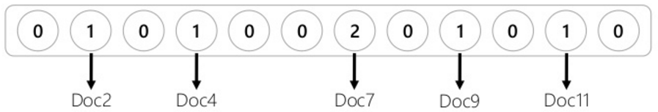
Vector Space Models
Represent an item (e.g., word) as a Vector of numbers.
banana
The vector can correspond to documents in which the word occurs.

Slide 5
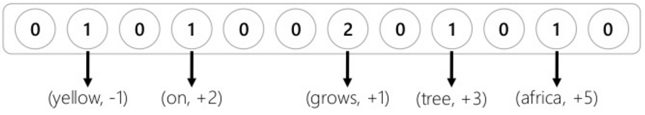

Vector Space Models
Represent an item (e.g., word) as a Vector of numbers.
banana
The vector can correspond to neighboring word context.
$$e.g., “yellow banana grows on trees in africa”$$
-1 0 +1 +2 +3 +4 +5

Slide 6
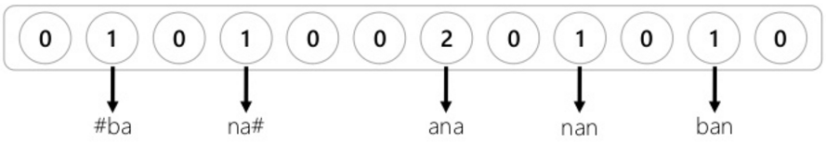
Vector Space Models
Represent an item (e.g., word) as a Vector of numbers.
banana
The vector can correspond to character trigrams in the word.

Slide 7
Notions Of Relatedness
Comparing two vectors (e.g., using cosine similarity) estimates how similar the two words are. However, the notions of relatedness depends on what vector representation you have chosen for the words.
seattle similar to denver? or seattle similar to seahawks?
Because they are both cities. Because ”seattle seahawks”. (Go seahawks!)
Important note: In previous slides I showed raw counts. They should either be normalized (e.g, using pointwise-mutual information) or (matrix) factorized. More on that Iater…

Slide 8
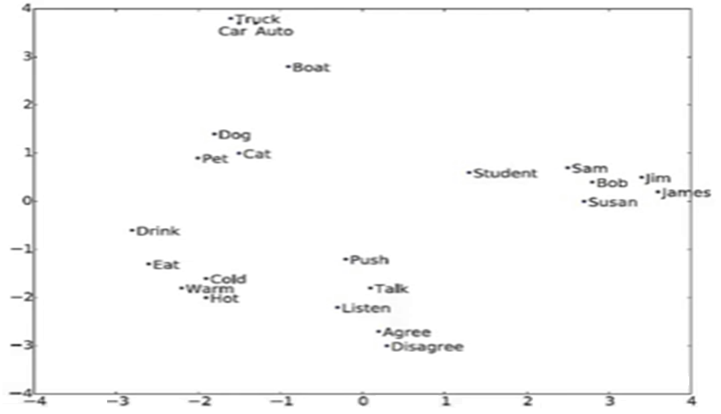
Word Embeddings
Word vector projected by their two principal components.

Slide 9
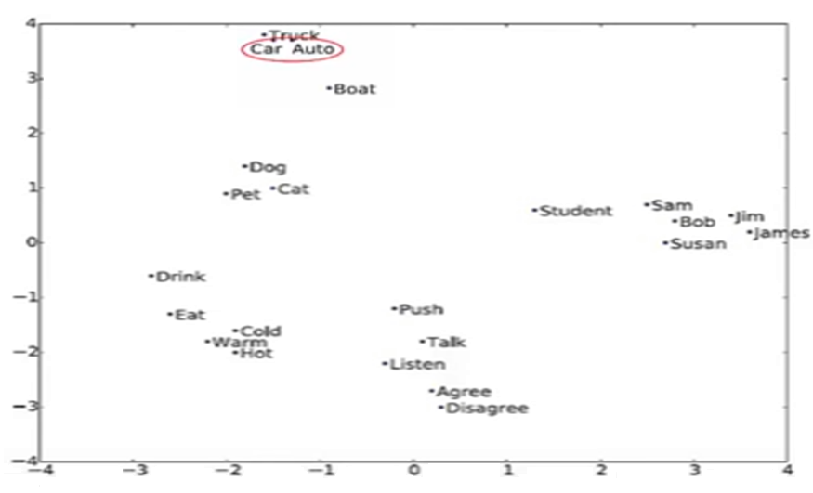
Word Embeddings
Synonym
A word having the same or nearly the same meaning as another word in certain contexts.
Beautiful: Attractive, Pretty, Lovely, Stunning

Slide 10
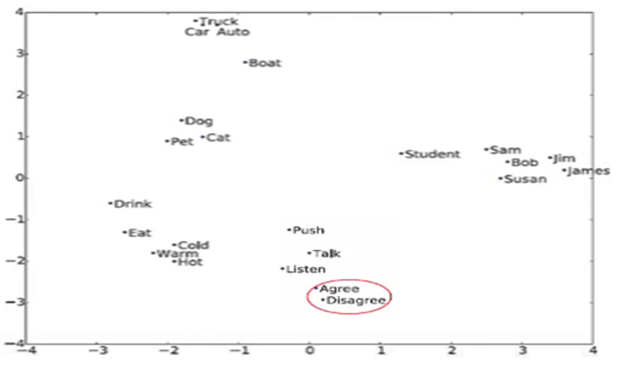
Word Embeddings
Antonym
A word that is opposite in context of another word although similar in other respects.
Afraid – Confident

Slide 11
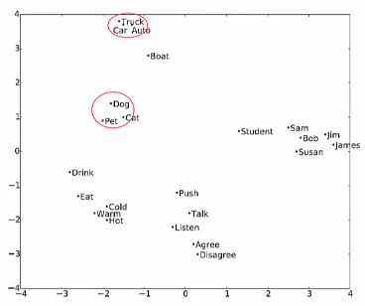
Word Embeddings
Hypernym
A word whose meaning includes the meanings of other words.
Flower is a hypernym of daisy and rose.
Truck is a type of car.

Slide 12
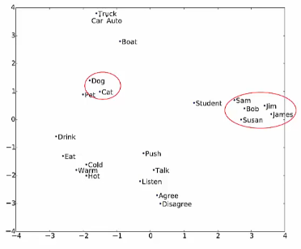
Word Embeddings
Hyponym
A term used to designate a particular member of a broader class.
Cat and rabbit are co-hyponyms of the hypernym animal.

Slide 13
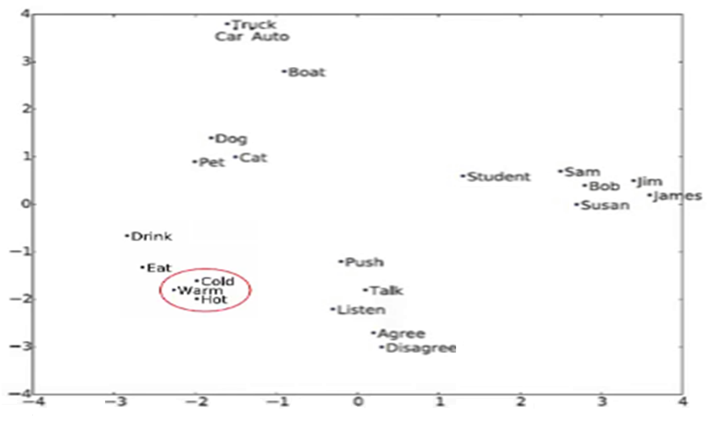
Word Embeddings
Words are values on a scale: hot, warm, cold.

Slide 14
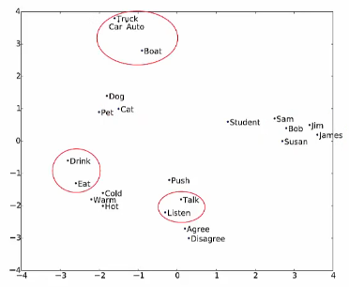
Word Embeddings
Words appear in similar contexts.

Slide 15
Let's Consider The Following Example…
We have four (tiny) documents,
Document 1 : “seattle seahawks jerseys”
Document 2 : “seattle seahawks highlights”
Document 3 : “denver broncos jerseys”
Document 4 : “denver broncos highlights”

Slide 16
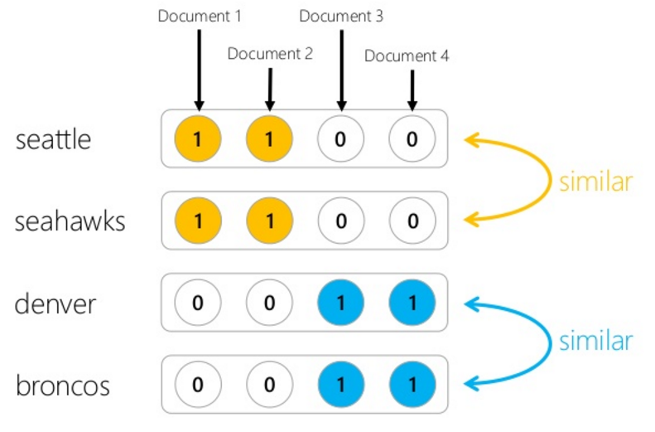
If We Use Document Occurrence Vectors...
In the rest of this talk, we refer to this notion of relatedness as Topical similarity.

Slide 17
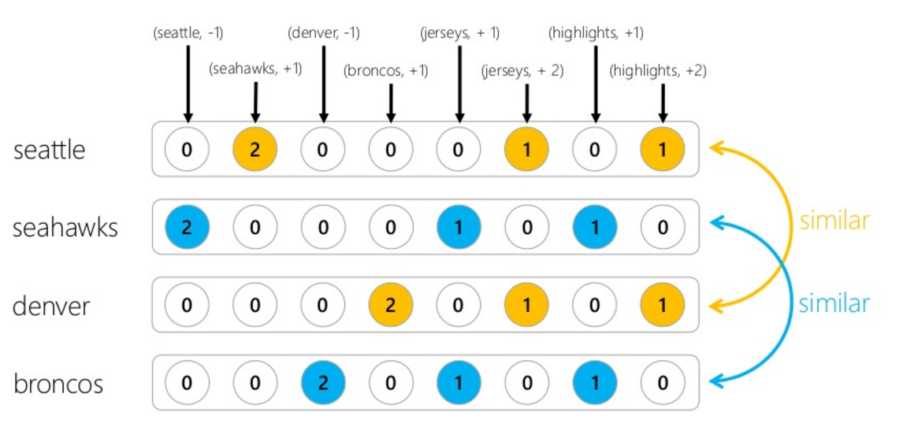
If We Use Word Context Vectors...
In the rest of this talk, we refer to this notion of relatedness as Topical (by-type) similarity.

Slide 18
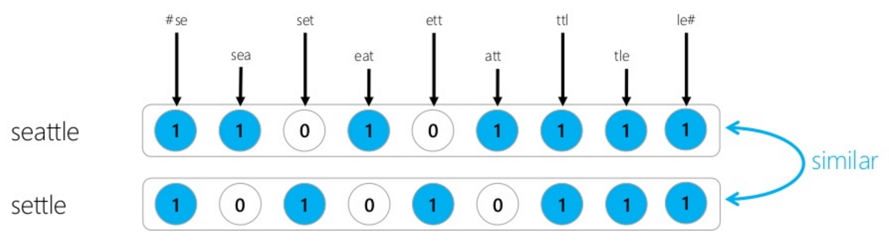
If We Use Character Trigrams Vectors...
This notion of relatedness is similar to string edit-distance.

Slide 19
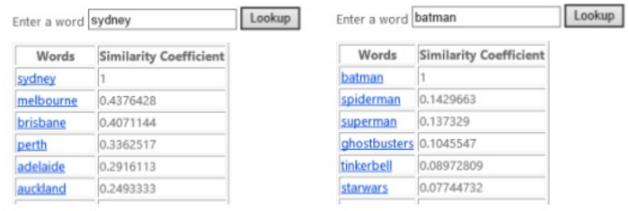
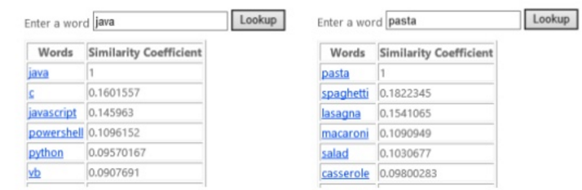
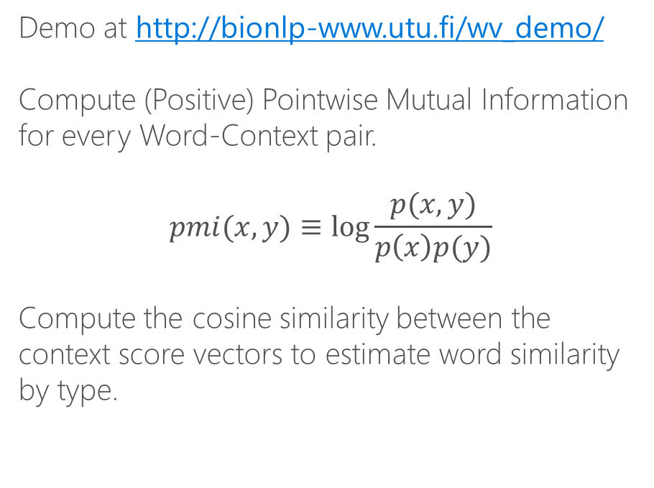
DIY: Learning Word Types
Demo at http://bionlp-www.utu.fi/wv_demo/
Compute (Positive) Pointwise Mutual Information for every Word-Context pair.
$$pmi(x,y)≡\log{\frac{p(x,y)}{p\left(x\right)p(y)}}$$
Compute the cosine similarity between the context score vectors to estimate word similarity by type.

Slide 20
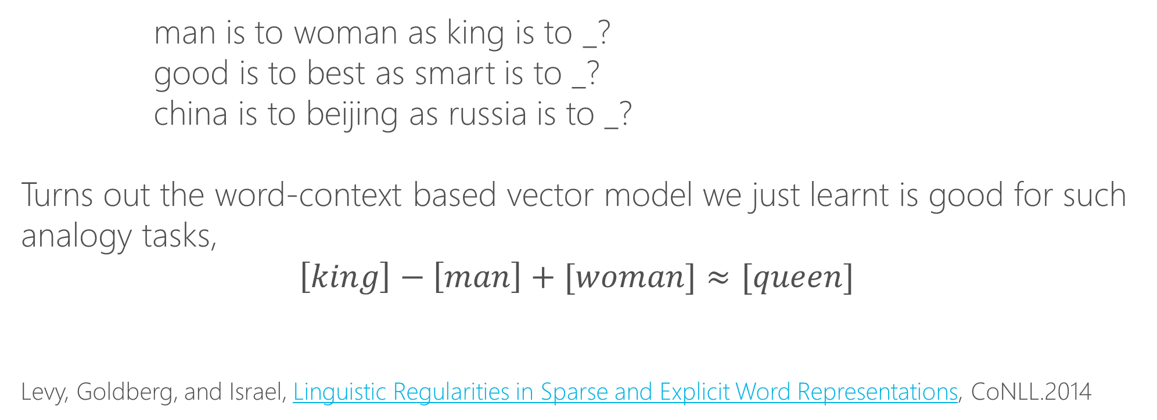
Word Analogy Task
man is to woman as king is to _?
good is to best as smart is to _?
china is to beijing as russia is to _?
Turns out the word-context based vector model we just learnt is good for such analogy tasks,
$$\left[king\right]−\left[man\right]+[woman]≈[queen]$$
Levy, Goldberg, and Israel, Linguistic Regularities in Sparse and Explicit Word Representations, CoNLL.2014

Slide 21
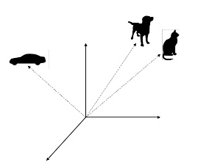
Embeddings
The vectors we have been discussing so far are very high-dimensional (thousands, or even millions) and sparse.
But there are techniques to learn lower-dimensional dense vectors for words using the same intuitions.
These dense vectors are called embeddings.

Slide 22
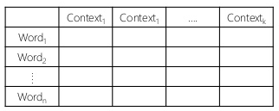
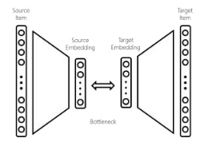
Learning Dense Embeddings
Matrix Factorization
Factorize word-context matrix.
E.g.,
LDA (Word-Document),
GloVe (Word-NeighboringWord)
Neural Networks
A neural network with a bottleneck, word and context as input and output respectively.
E.g.,
Word2vec (Word-Neighboringword)
Deerwester, Dumais, Landauer, Furnas, and Harshman, Indexing by latent semantic analysis, JASIS,1990.
Pennington, Socher, and Manning, GloVe: Global Vectors for Word Representation, EMNLP, 2014. Mikolov, Sutskever, Chen, Corrado, and Dean, Distributed resentations of Words and phrases and their compositionality, NIPS, 2013.

Slide 23
Exercise
Both Word2vec and Glove define context as the neighboring word only, without considering the distance from the current word.
How does this change the relationship that is learnt by the embedding space?

Slide 24
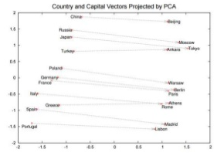
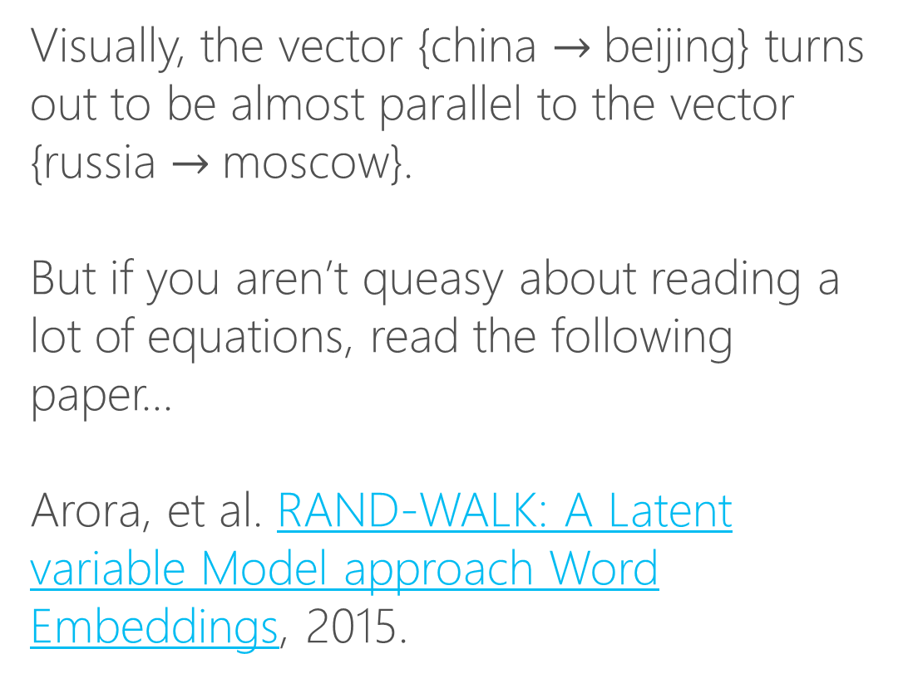
How Do Word Analogies Work?
Visually, the vector {china $→$beijing} turns out to be almost parallel to the vector {russia $→$moscow}.
But if you aren’t queasy about reading a lot of equations, read the following paper…
Arora, et al. RAND-WALK: A Latent variable Model approach Word Embeddings, 2015.
Mikolov, Sutskever, Chen, Corrado, and Dean, Distributed representations of words and phrasses and their compositionality, NIPS, 2013.

Slide 25
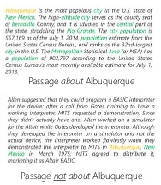
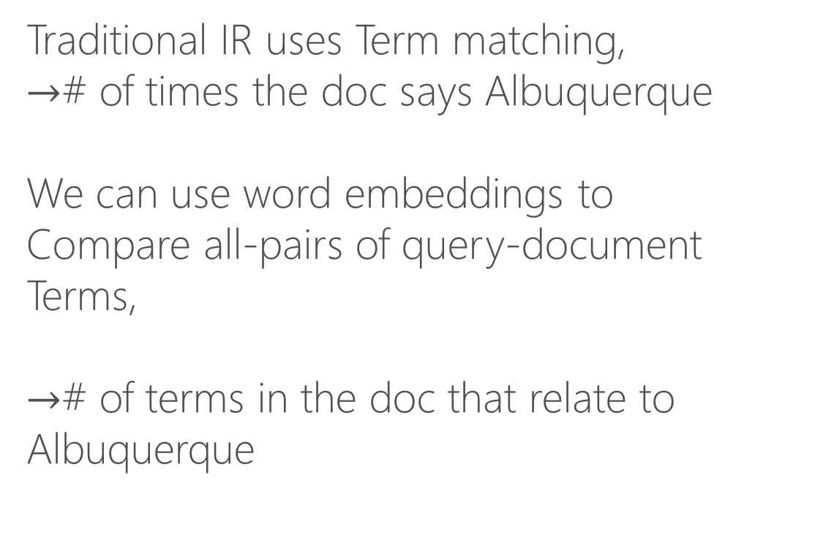
Word Embeddings For Document Ranking
Traditional IR uses Term matching,
$→$# of times the doc says Albuquerque
We can use word embeddings to
Compare all-pairs of query-document
Terms,
$→$# of terms in the doc that relate to Albuquerque
Nalisnick, Mitra , Craswell, and Caruana, Improving Document Ranking with Dual Word Embeddings, in www, 2016. Mitra, Nalisnick Craswell, and Caruana, A Dual Embeddings Space model for Document Ranking arxlv:160201137, 2016

Slide 26
What’s Next?
Train your own or use a pre-trained embedding
Word2vec
Word2vec trained on queries
GloVe

Slide 27
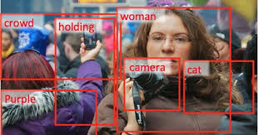
Remember These Are Exciting Times…
Human: What is the purpose of life?
Machine: To serve the greater good.
Human: What is the purpose of living?
Machine: To live forever.
Human: What is the purpose of existence?
Machine: To find out what happens when we get to the planet earth.
Human: Where are you now?
Machine: I'm in the middle of nowhere.
Human: What is the purpose of dying?
Machine: To have a life.
Human: What is the purpose of being intelligent?
Machine: To find out what it is.
Human: What is the purpose of emotions?
Machine: I don't know.
Fang et.al., From Captions to Visual Concepts and Back, CVPR, 2015.
Vinyals et.al. A Neural Conversational Model, ICML.2015.

